Slide 1
Chapter four
INPUT MODELING

Slide 2
INPUT MODELING
Input models provide the driving force for a simulation model.
There are four steps in the development of a useful model of input data:
Collect data from the real system
Identify a probability distribution to represent the input process
Choose parameters for the distribution
Evaluate the chosen distribution and parameters for goodness of fit.
Goodness-of-fit may be evaluated informally via graphical methods, or formally via statistical tests.
The chi-square and the Kolmogorov-Smirnov tests are standard goodness-of-fit tests

Slide 3
Data Collection
One of the biggest tasks in solving a real problem. GIGO – garbage-in-garbage-out
Suggestions that may enhance and facilitate data collection:
Plan ahead: begin by a practice or pre-observing session, watch for unusual circumstances
Analyze the data as it is being collected: check adequacy
Combine homogeneous data sets, e.g. successive time periods, during the same time period on successive days
Be aware of data censoring: the quantity is not observed in its entirety, danger of leaving out long process times
Check for relationship between variables, e.g. build scatter diagram
Check for autocorrelation
Collect input data, not performance data(output data)

Slide 4
PURPOSE OF DATA COLLECTION
By now you have known that data could be classified in the following three ways:
Quantitative and Qualitative Data.
Sample and Census Data.
Primary and Secondary data.
Quantitative and Qualitative data: Quantitative data are those set of information which are quantifiable and can be expressed in some standard units like rupees or birr, kilograms, liters
Qualitative data, on the other hand, are not quantifiable, that is, cannot be expressed in standard units of measurement like kilograms, liters, etc.

Slide 5
This is because they are 'features', 'qualities' or 'characteristics' like eye colors, skin complexion, honesty, good or bad, etc. These are also referred to as attributes.
B) Sample and Census Data: It can be collected either by census method or sample method.
Information collected through sample inquiry is called sample data and the one collected through census inquiry is called census data.
C) Primary and Secondary Data: The Primary data are collected by the investigator through field survey. Such data are in raw form and must be refined before use.
On the other hand, secondary data are extracted from the existing published or unpublished sources, which are from the data already collected by others.

Slide 6
methods to collect primary data
The following methods to collect primary data
a) Direct Personal Investigation
b) Indirect Oral Investigation
c) Use of Local Reports
d) Questionnaire Method

Slide 7
Identifying the Distribution with Data
In this section we discuss methods for selecting families of input distributions when data are available.
Histogram
A frequency distribution or histogram is useful in identifying the shape of a distribution.
A histogram is constructed as follows:
Divide the range of the data into intervals
Label the horizontal axis to confirm to the intervals selected
Determine the frequency of occurrences within each interval.
Plot the frequencies on the vertical axis.

Slide 8
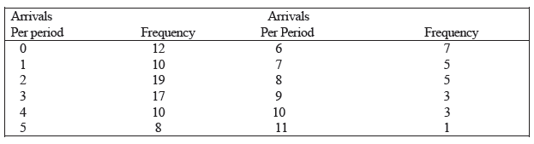
Example 4.1:
The number of vehicles arriving at the northwest corner of an intersection in a 5 min period between 7 A.M. and 7:05 A.M. was monitored for five workdays over a 20-week period. Table shows the resulting data. The first entry in the table indicates that there were 12:5 min periods during which zero vehicles arrived, 10 periods during which one vehicles arrived, and so on,

Slide 9
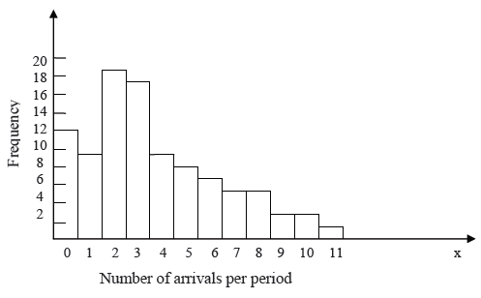
Fig 4.1 Histogram of number of arrivals per period

Slide 10
Selecting the Family of Distributions
A family of distributions is selected on the basis of what might arise in the context being investigated along with the shape of the histogram.
The context (background) of the input variable
Shape of the histogram
Here are some examples:
Binomial: Models the number of successes in ‘n’ trials, when the trials are independent with common success probability p, for example, the number of defective computer chips found in a lot of ‘n’ chips.
Poisson: Models the number of independent events that occur in a fixed amount of time or space: for example, the number of customers that arrive to a store during 1 hour, or the number of defects found in 30 square meters of sheet metal

Slide 11
iii. Normal: Models the distribution of a process that can be thought of as the sum of a number of component processes; for example, the time to assemble a product which is the sum of the times required for each assembly operation.
iv. Lognormal: Models the distribution of a process that can be thought of as the product of (meaning to multiply together) a number of component processes; for example, the rate of return on an investment, when interest is compounded, is the product of the returns for a number of periods.
v. Exponential: Models the time between independent events, or a process. for example, the times between the arrivals of a large number of customers who act independently of each other
vi. Empirical : Resample from the actual data collected; often used when no theoretical distribution seems appropriate

Slide 12
vii. Gamma: An extremely flexible distribution used to model nonnegative random variables. The gamma can be shifted away from 0 by adding a constant.
viii. Beta: An extremely flexible distribution used to model bounded (fixed upper and lower limits) random variables.
ix. Erlang: Models processes that can be viewed as the sum of several exponentially distributed processes; for example, a computer network fails when a computer and two backup computers fail, and each has a time to failure that is exponentially distributed.
x. Weibull: Models the time to failure for components; for example, the time to failure for a disk drive
xi. Triangular : Models a process when only the minimum, most-likely, and maximum values of the distribution are known; for example, the minimum, most likely, and maximum time required testing a product.

Slide 13


Parameter Estimation
After a family of distributions has been selected, the next step is to estimate the parameters of the distribution
Preliminary Statistics: Sample Mean and Sample Variance
In a number of instances the sample mean and sample variance, are used to estimate of the parameters of hypothesized distribution.
If the observations in a sample of size n are X₁, X₂,..., X_{n}, the sample mean ( ) is defined by 4.1
and the sample variance, s² is defined by
4.2

Slide 14


If the data are discrete and grouped in frequency distribution, Equation 4.1 and 4.2 can be modified to provide for much greater computational efficiency, the sample mean can be computed by 4.3
And the sample variance by 4.4
where f_{j} is the observed frequency of value X_{j}
Example(for group data)
Vehicle Arrival in the histogram example on the following table can be analyzed to obtain: The sample mean and variance are

Slide 15
The sample standard deviation S is just the square root
of the sample variance in this case s= 7.63= 2.76.
Equation 4.1 and 4.2 would have yielded exact the
same result for and S²
The histogram suggests X to have a Poisson distribution .

Slide 16
Goodness-of-Fit Tests
Goodness-of-fit tests provide help full guidance for evaluating the suitability of a potential input model.
Conduct hypothesis testing on input data distribution using:
Kolmogorov-Smirnov test
Chi-square test
No single correct distribution in a real application exists.
If very little data are available, then a goodness-of-fit test is unlikely to reject any candidate distributions
If a lot of data are available, then a goodness-of-fit test is is likely to reject all candidate distributions

Slide 17
Chi-Square test
Intuition: comparing the histogram of the data to the shape of the candidate density or mass function
Valid for large sample sizes when parameters are estimated by maximum likelihood
By arranging the n observations into a set of k class intervals or cells, the test statistics is:
which approximately follows the chi-square distribution with k-s-1 degrees of freedom, where s represent the number of parameters of the hypothesized distribution estimated by the sample statistics.
Expected Frequency
E_{i} = n*p_{i}
where p_{i} is the theoretical prob. of the ith interval.
Suggested Minimum = 5
Observed Frequency
17
Notes:
17

Slide 18
The hypothesis of a chi-square test is:
H₀: The random variable, X, conforms to the distributional assumption with the parameter(s) given by the estimate(s).
H₁: The random variable X does not conform.
The critical value X²α,k-s-1 is found in the table A-6, the null hypothesis, H₀ is rejected if X²₀ > X²α,k-s-1

Slide 19
p-Values and "Best Fits"
To apply a goodness-of-fit test a significance level must be chosen. The traditional significance levels are 0.1,0.05, and 0.01. Prior to the availability of high-speed computing, having a small set of standard values made it possible to produce tables of useful critical values.
Thus, if the analyst prefers a level of significance of, say, 0.07, then he or she can choose it. However, rather than require a pre specified significance level, many software packages compute a p-value for the test statistic.
The p-value can be viewed as a measure of fit, with larger values being better. This suggests that we could fit every distribution at our disposal, compute a test statistic for each fit, and then choose the distribution that yields the largest p-value.

Slide 20
Selecting Input Models without Data
If data is not available, some possible sources to obtain information about the process are:
Engineering data: often product or process has performance ratings provided by the manufacturer or company rules specify time or production standards.
Expert option: people who are experienced with the process or similar processes, often, they can provide optimistic, pessimistic and most-likely times, and they may know the variability as well.
Physical or conventional limitations: physical limits on performance, limits or bounds that narrow the range of the input process.
The nature of the process.
The uniform, triangular, and beta distributions are often used as input models

Slide 21
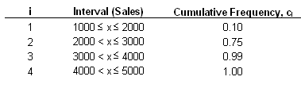
Example: Production planning simulation.
Input of sales volume of various products is required, salesperson of product XYZ says that:
No fewer than 1,000 units and no more than 5,000 units will be sold.
Given her experience, she believes there is a 90% chance of selling more than 2,000 units, a 25% chance of selling more than 2,500 units, and only a 1% chance of selling more than 4,500 units.
Translating these information into a cumulative probability of being less than or equal to those goals for simulation input:

Slide 22
Multivariate and Time-Series Input Models
If input variables are not independent their relationship must be taken into consideration (multivariable input model).
If input variables constitute a sequence (in time) of related random variables, their relationship must be taken into account (time-series input model).
Multivariate:
For example, lead time and annual demand for an inventory model, increase in demand results in lead time increase, hence variables are dependent.
Time-series:
For example, time between arrivals of orders to buy and sell stocks, buy and sell orders tend to arrive in bursts, hence, times between arrivals are dependent

Slide 23
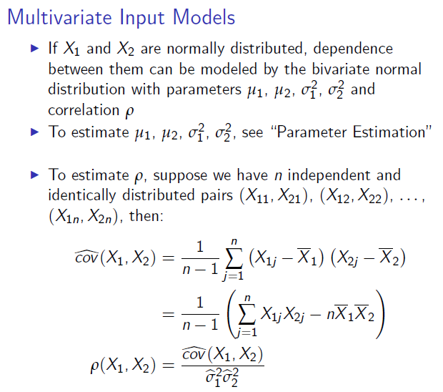
Sample standard deviation

Slide 24
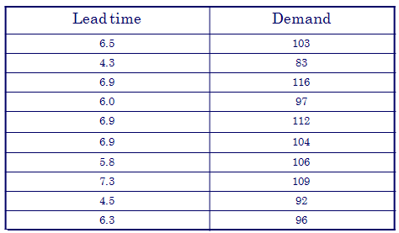
Example: Let X₁ represent the average lead time to deliver in months and X₂ is the annual demand for industrial robots. The following data were available on demand and lead time for the last 10 years

Slide 25
From this data we can calculate:
Correlation is estimated as:
The closer is to -1 or 1, the stronger the linear relationship is b/n
X₁ and X_{2 .}
Clearly lead time and demand are strongly dependant. Before accepting this model, However, lead time and demand should be checked individually to see if they are well represented by normal distribution.

Slide 26
Thank You?

